Slide 1


Caught in the Net
Understanding Phishing and Password Theft—Weak vs. Strong

Slide 2
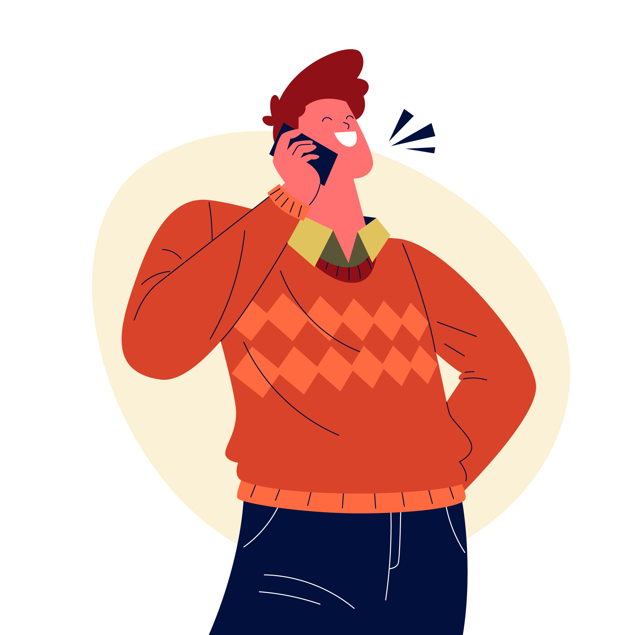
Case Study : Phishing Attack via Phone Survey
“Jordan is sitting at home, receiving a phone call. The caller ID displays a number that seems to be from their bank.”
Alex (Phisher): [Cheerful tone] "Good afternoon! This is Alex from XYZ Bank. May I speak with Jordan, please?“
Jordan (Victim): [A bit cautious but curious] "Yes, this is Jordan. How can I help you?"
Alex (Phisher): "Great, thank you for taking my call. We’re conducting a quick survey to ensure that our customer service meets your expectations. It’ll only take a few minutes. Can you spare some time for this?"
Jordan (Victim): [Relieved it’s not a sales call] "Sure, I can do that. What do you need from me?"
Alex (Phisher): "Fantastic! To get started, I just need to verify a few details to confirm your identity. Could you please provide me with your full name and address?"

Slide 3
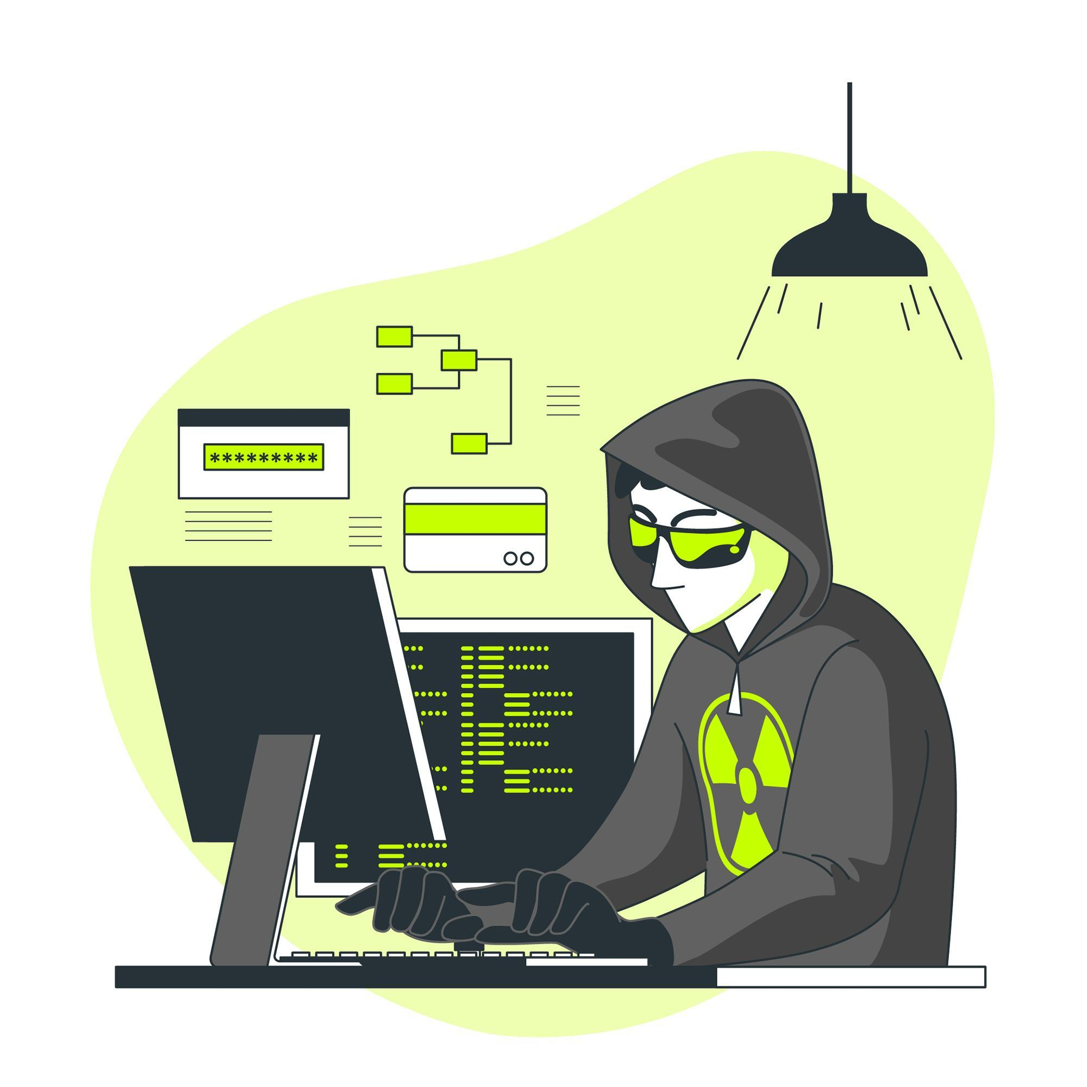
Case Study : Phishing Attack via Phone Survey
Jordan (Victim): [Not suspicious] "Sure, my name is Jordan Smith, and my address is 123 Maple Street."
Alex (Phisher): "Thank you, Jordan. Next, could you please provide the last four digits of your Social Security number? This helps us ensure we have the correct record."
Jordan (Victim): [Somewhat hesitant but complies] "Alright, it’s 6789."
Alex (Phisher): "Perfect! Now, as part of our survey, could you confirm the name of your favorite bank account, or the one you use the most frequently?"
Jordan (Victim): "Yes, it’s the Savings Account."
Alex (Phisher): "Excellent. Finally, just to make sure we’re updating your profile accurately, could you provide the answers to your security questions? For instance, what was your first pet’s name?“
Jordan (Victim): [Answers without much thought] "Fluffy."

Slide 4
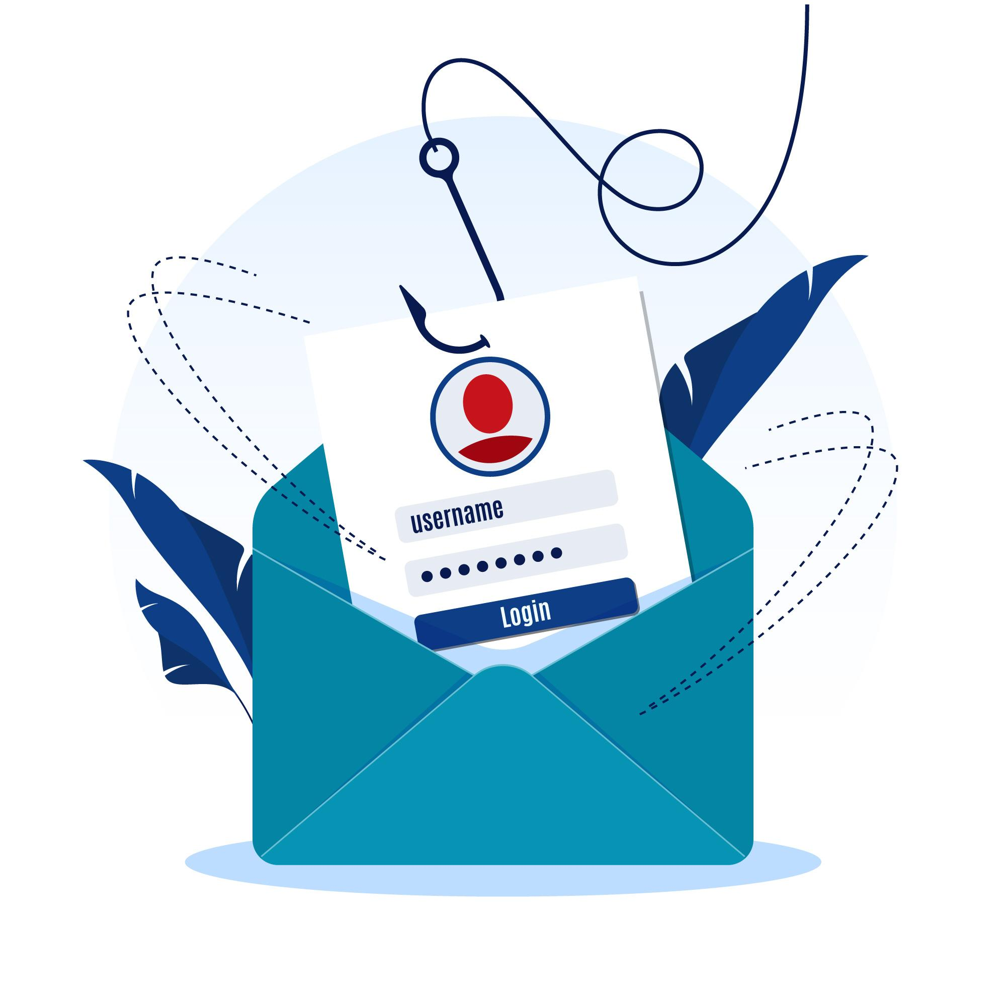
Case Study : Phishing Attack via Phone Survey
Alex (Phisher): "Thanks, Jordan! That’s all I need for the survey. I appreciate your time today. Have a great day!"
Jordan (Victim): "You too, thanks!"
“A few moments later, Alex (Phisher) uses simple online tools to guess Jordan's password.”
Alex (Phisher) in a separate location:
Alex (Phisher): [Types on a computer] "Let’s see… Jordan’s pet was Fluffy, and they use their Savings Account the most. Time to use some common password-cracking tools."
[Uses online password cracking tools with the information gathered.]
Alex (Phisher): [Types in common variations of passwords like “Fluffy123” or “SavingsAccount2024” based on the gathered info.] "Got it! It looks like I’ve found their password. Now I can access their account."
[Accesses the victim’s bank account using the compromised information.]

Slide 5
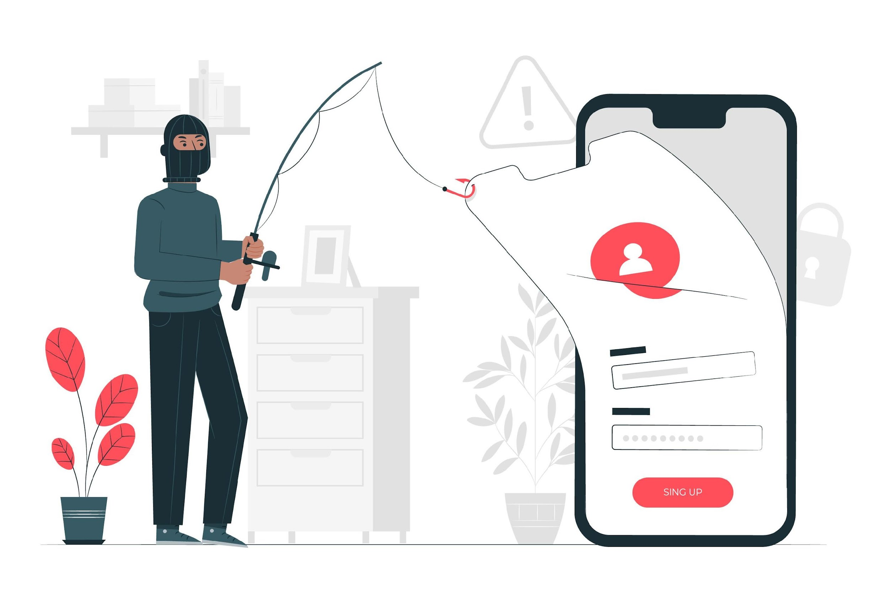
Key Takeaways for Victims:
Verify Callers: Always verify if a call claiming to be from your bank or any institution is legitimate.
Avoid Sharing Sensitive Information: Do not share personal information, Social Security numbers, or answers to security questions over the phone.
Use Strong, Unique Passwords: Use complex passwords that are not easily guessable, even with some personal information.
Be Skeptical: Always question the legitimacy of unsolicited calls or messages requesting personal information.

Slide 6
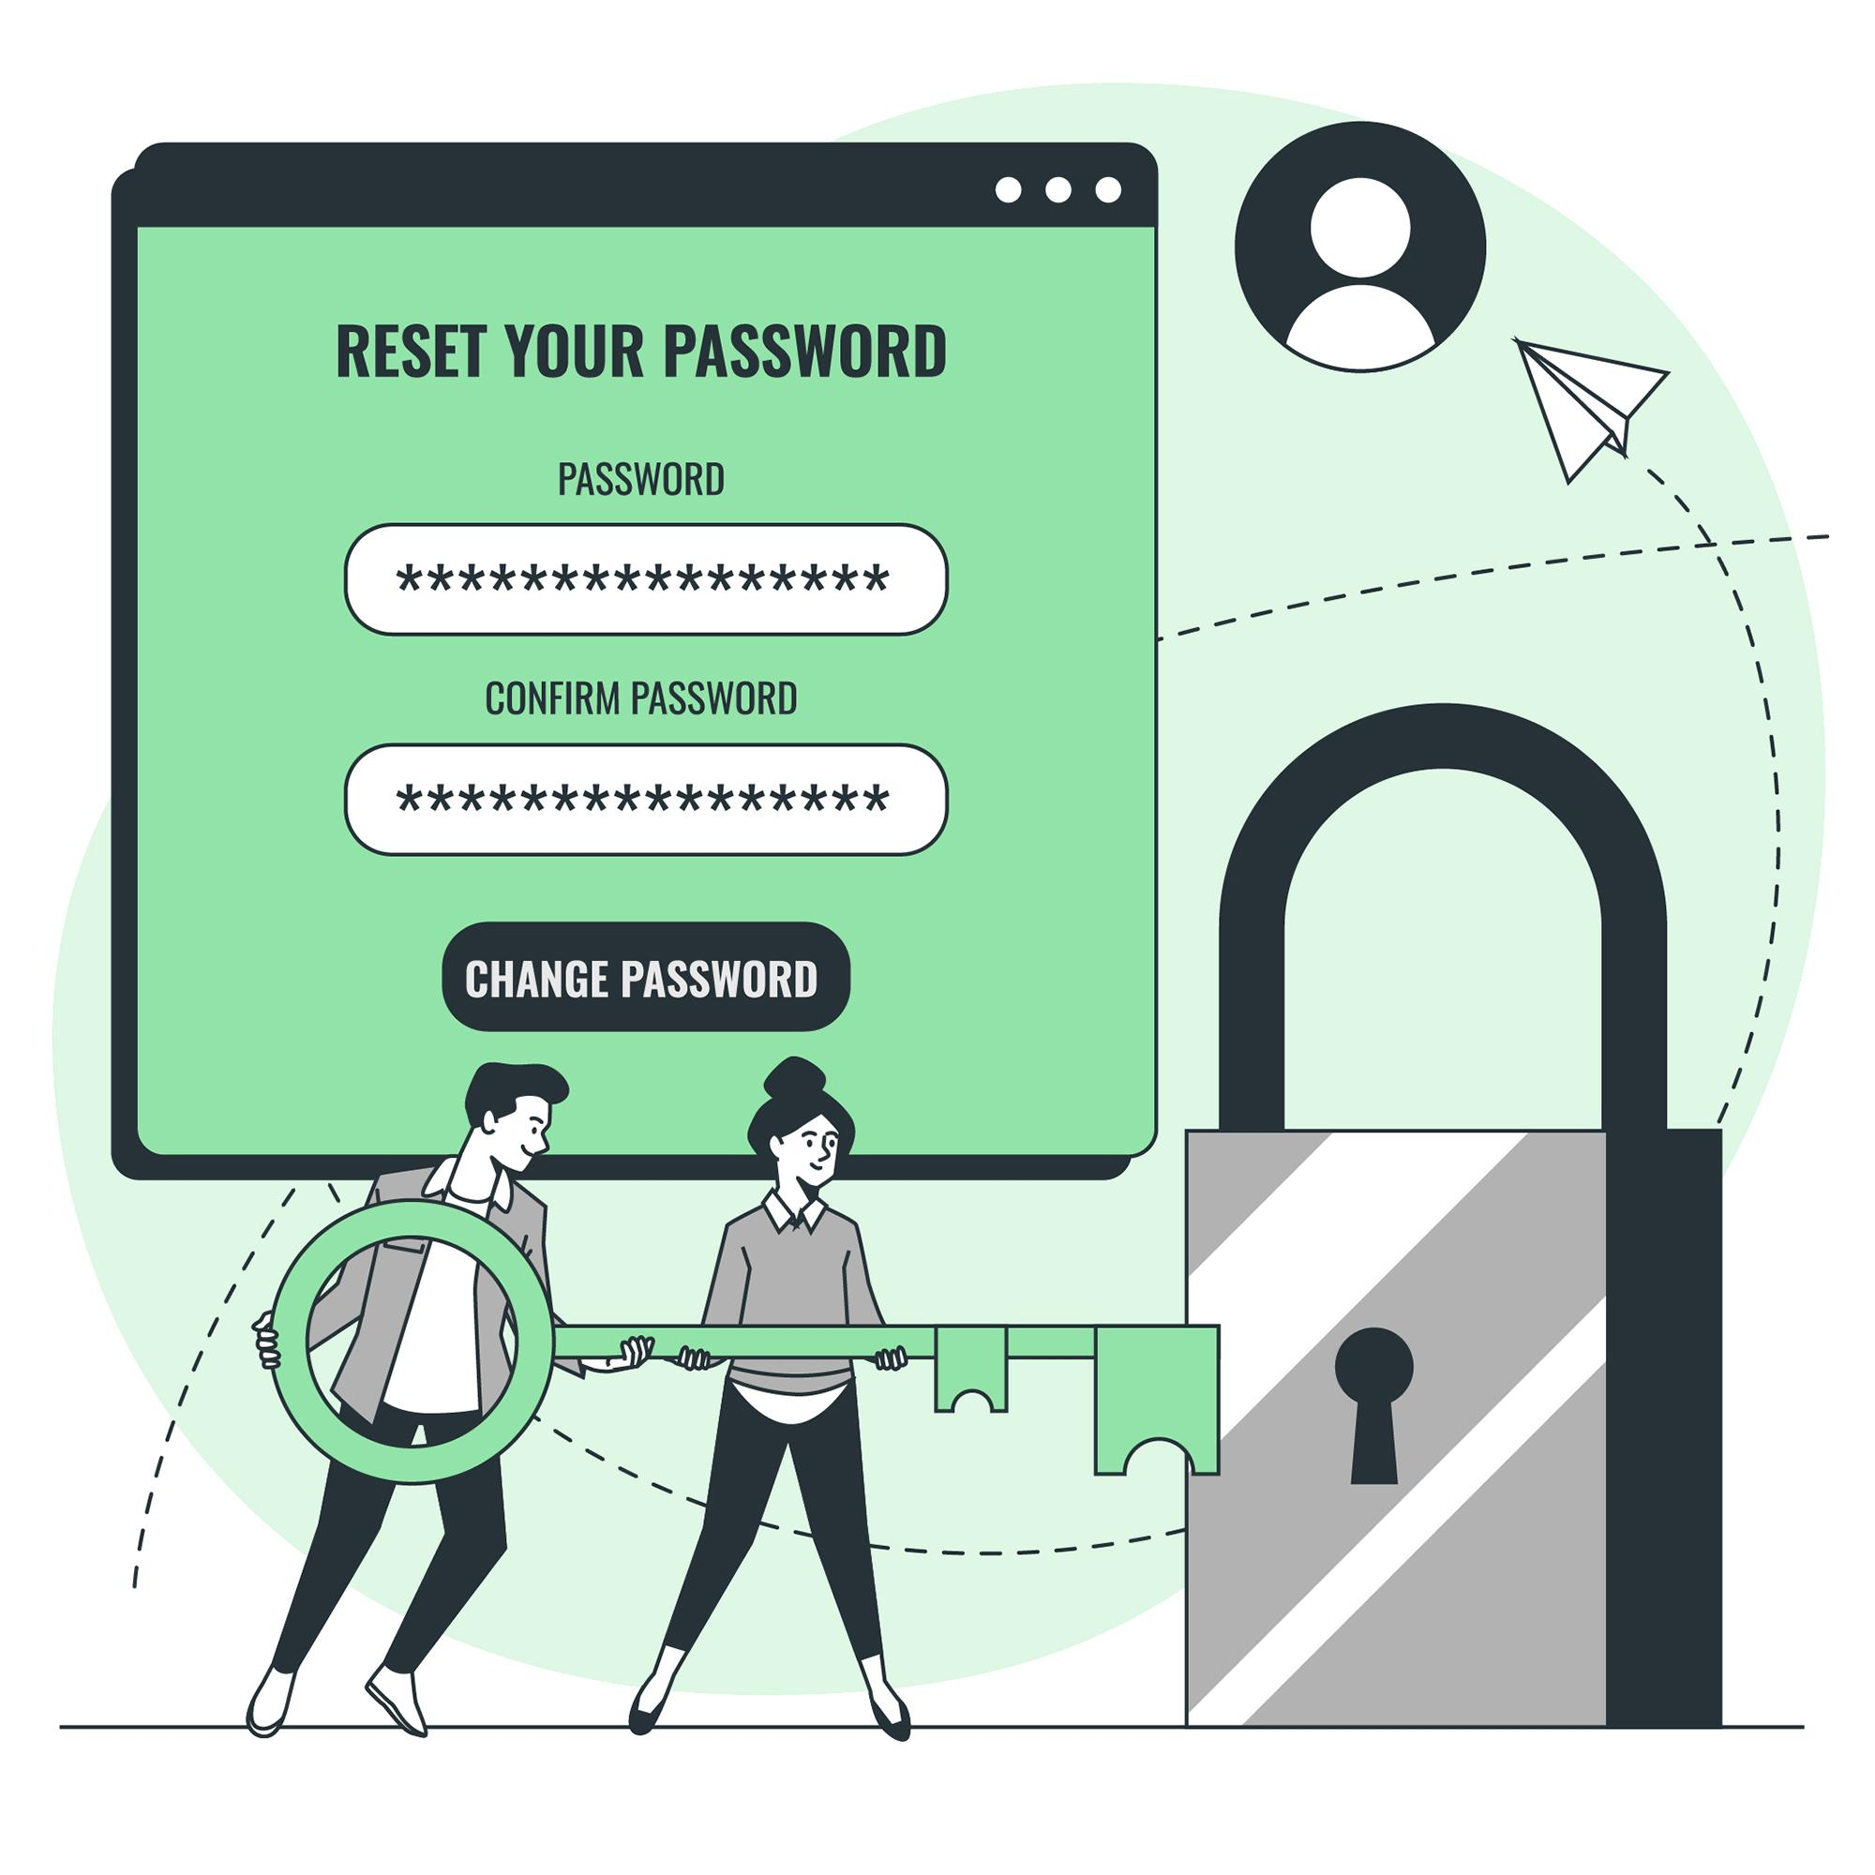
Concise guide for creating strong passwords:
Length: Use at least 12-16 characters.
Mix Characters: Combine uppercase and lowercase letters, numbers, and special characters.
Avoid Common Words: Don’t use easily guessable information or patterns.
Use Passphrases: Create a phrase with random words and symbols.
Unique Passwords: Use different passwords for each account.
Password Manager: Use one to generate and store complex passwords.
Update Regularly: Change passwords periodically.
Enable MFA: Use multi-factor authentication for extra security.
Example: G7!xT@1&lM#oQ9$ or Green^Tiger!Cloudy12%Sky

Slide 7
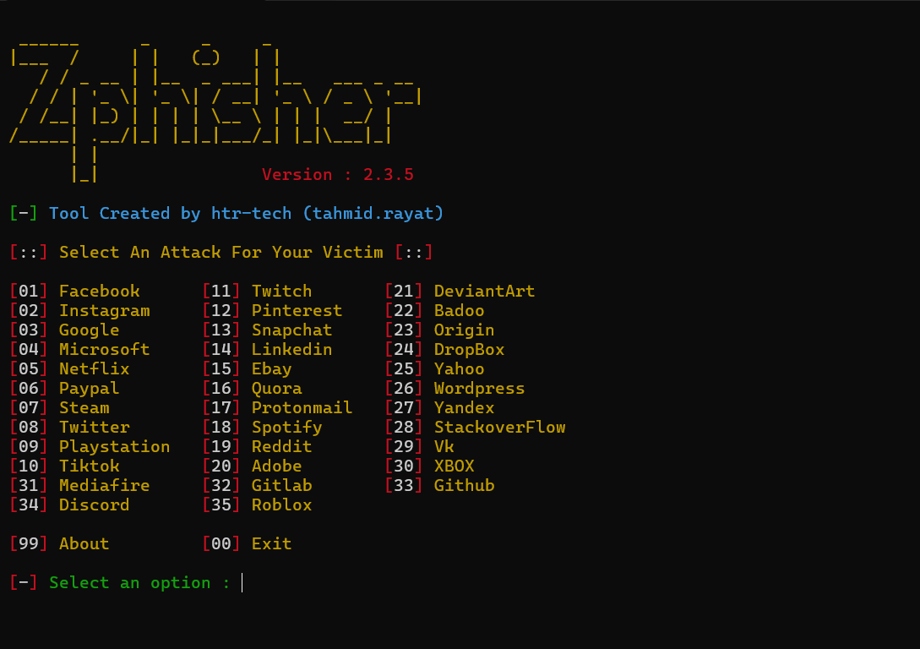
Tools that can be used in such cases:
Hidden for security purpose

